Slide 1


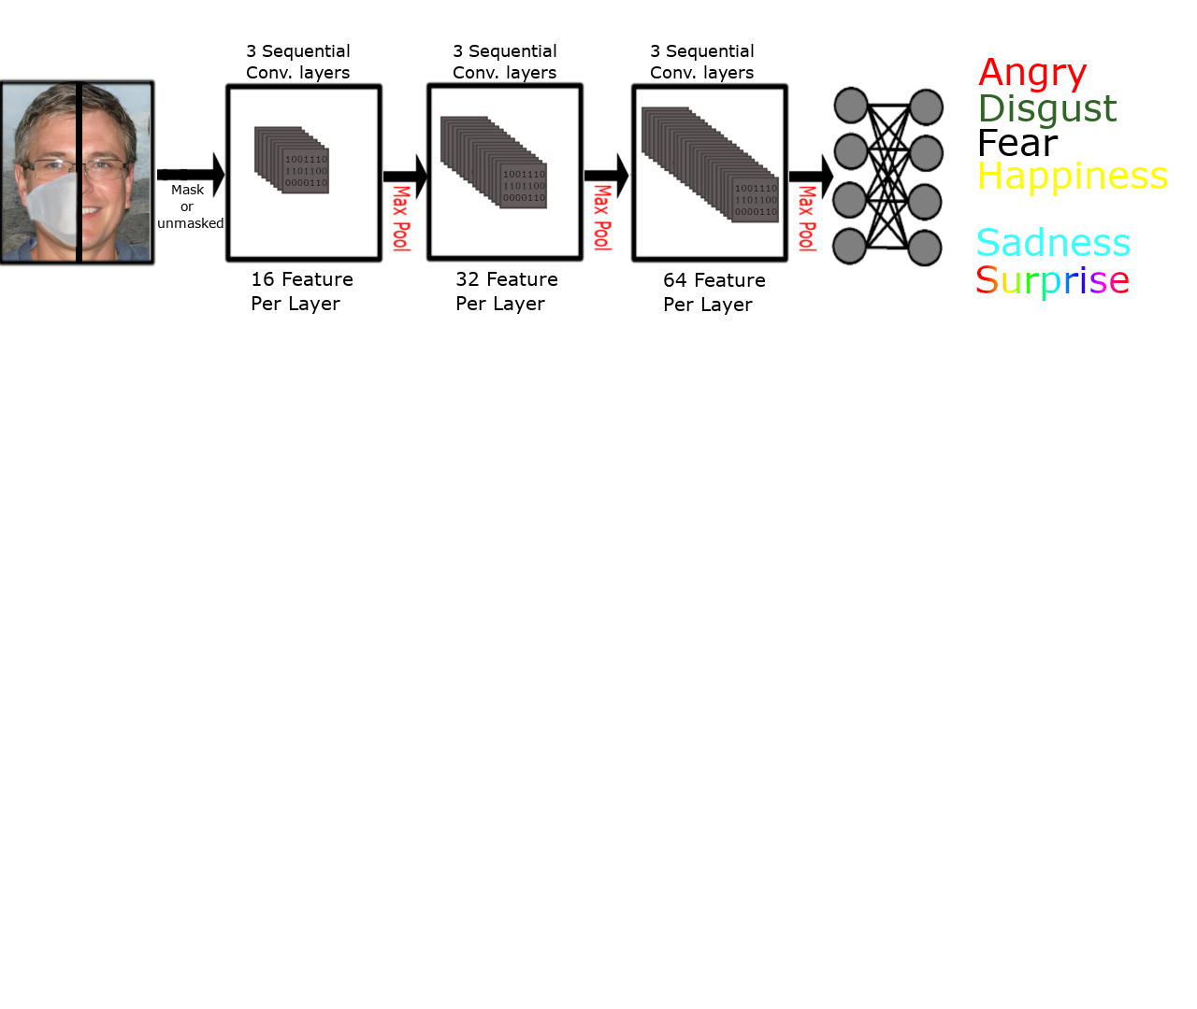
Machines vs Humans
Facial Emotional Recognition in People Wearing And Not Wearing Masks
Student: Samuel Sturrock | Supervisor: Sefki Kolozali
Introduction
During the covid-19 epidemic, a slew of new issues has emerged. One that is sometimes ignored is how people interact with one another. According to most studies, nonverbal communication accounts for 62 percent of the conversation[1], therefore it's not hard to imagine that the new trend of wearing face masks has resulted in a significant amount of communication being lost. One alternative is to use machines to bridge the gap of lost knowledge. This has a variety of uses, including assisting those in society who have been harmed the most by the loss of information, such as persons with ASD.
Method
Several image dataset are collected based on emotion. The images in this dataset are preprocessed. This means that the viola-jones algorithm will crop just the face or discard the image if it has not been found. (this is to remove unnecessary bits of information for the software to process.)
This data is then split into the respected class, which emotion they belong to, and then further randomly split into groups for testing and training in order to evaluate the effectiveness of two machine learning algorithms they will be fed to: a CNN and decision tree.
Convolutional Neutral Network CNN
Convolution layer
The convolutional layer detects features from the image. It does this by turning the image into a matrix and using convolutions, filters, to extract key groups of data.
Pooling Layer
The pooling layer only takes the move important data, max values in this case, ignoring non important data.
Decision Trees
Decision trees are a simple way to classify things. They set conditions based on features and if the input matches the feature then in will go down that branch of the node. A simple example is provide above, however, to achieve results from this projects several trees are you used with the tree itself going much deeper.
Results
CNN
Mask | No-Mask
80% 60%
Decision Trees*
Masks | No-Mask
X X
People[2]*
Masks | No-Mask
Adults 85% 76%
Children 70% 62%
Toddlers 68% 44%
References
[1]https://cornerstone.lib.mnsu.edu/ctamj/vol34/iss1/2/
[2]https://www.frontiersin.org/files/Articles/669432/fpsyg-12-669432-HTML/image_m/fpsyg-12-669432-g001.jpg
Dense layers
Sunny?
yes
no
Cloudy?
Cold
yes
no
Warm
Hot

